Slide 1
Intermolecular Forces
Unit 12, Part III

Slide 2
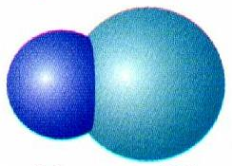
A. Polar Bonds
A bond between atoms of two different elements tends to be polar.
One end is slightly positive, the other is slightly negative.
This symbol: δ means “partial.”
This type of arrow: →
is a “dipole.”
δ⁺
δ⁻
H Cl
|

Slide 3
A. Polar Bonds
The dipole points toward the more electronegative atom.
DI – POLE =
two - poles
δ⁺
δ⁻
H Cl
Positive Pole
Negative Pole

Slide 4
Polar vs. Nonpolar MOLECULES
Nonpolar Molecules
Dipole moments are symmetrical and cancel out.
NO net
dipole
moment
B
AB₃
A
B
B

Slide 5
B. Determining Molecular Polarity
Polar Molecules
Dipole moments are asymmetrical and don’t cancel .
O
net
dipole
moment
H₂O
H
H

Slide 6
B. Determining Molecular Polarity
Therefore, polar molecules have...
Asymmetrical shape (unshared pairs on central atom (E)) or
Asymmetrical atoms
H
net
dipole
moment
CHCl₃
Cl
Cl
Cl

Slide 7
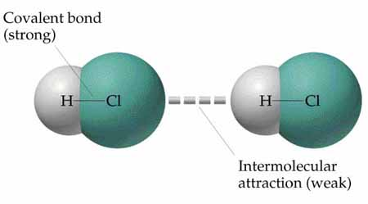
Intermolecular Forces (IMFs)
Intermolecular Forces = (Attraction) Forces between molecules
IMFs are much weaker than bonds
This ATTRACTION between the molecules is the IMF.

Slide 8
Intermolecular Forces (IMFs)
IMFs make the molecules of a substance more likely to stay together as a solid or liquid
Instead of separating into a gas.

Slide 9
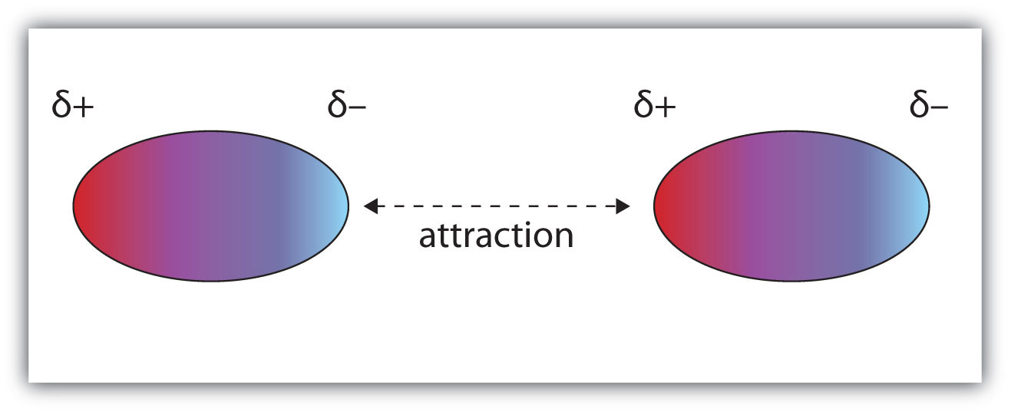
There are three types of IMF:
Dipole-Dipole (DD) is the simplest one to understand:
Opposites attract.
The negative end of one polar molecule attracts the positive end of another polar molecule.

Slide 10
Dipole-Dipole Interaction:
dipole
dipole
attracted to

Slide 11
Dipole-Dipole Interaction:
What is it?
Who has it?
How strong is it?
And?
Charge attraction between permanent dipoles
All polar molecules
Medium strength
It is stronger when the molecules are closer.

Slide 12
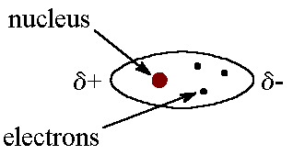
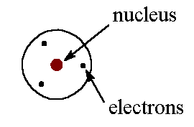
London Dispersion
London Dispersion (LD) is a temporary version of DD:
We usually assume electrons are evenly distributed in atoms/molecules.
But electrons are in constant motion, and can “disperse” themselves unevenly.

Slide 13
London Dispersion
This causes a temporary dipole:
A temporary dipole can cause a temporary dipole in other nearby molecules.

Slide 14
London Dispersion
Attraction between two instantaneous dipoles:
This leads to temporary or instantaneous (only lasting for an instant) attractions.

Slide 15
London Dispersion:
What is it?
Who has it?
How strong is it?
And?
Instantaneous attraction
between temporary dipoles due to uneven e⁻ dispersion
All atoms & molecules
Weakest strength
Stronger for molecules with greater masses.

Slide 16
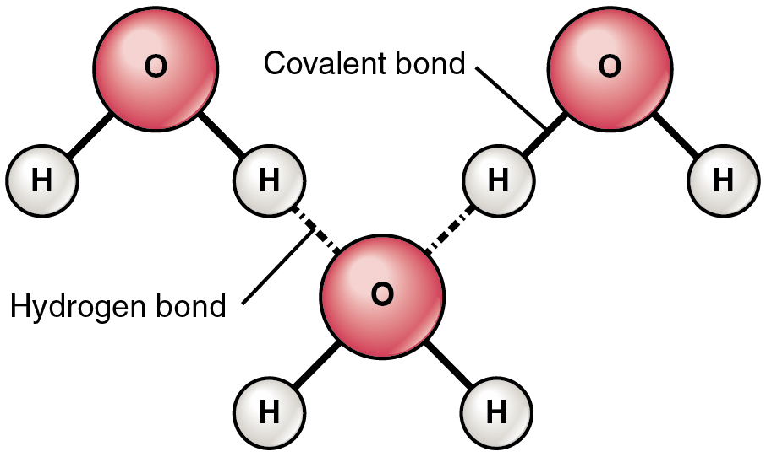
Hydrogen Bonding
Hydrogen Bonding (HB) is the extreme version of DD:
Extremely electronegative elements cause extremely polar bonds.
When hydrogen is involved, the dipole-dipole force is far stronger than usual.

Slide 17
Hydrogen Bonding
Hydrogen is special (as always) because it only has electrons in one energy level.
If a polar bond causes H to partially “lose” its only two electrons
to the element it is sharing with, wackiness ensues.

Slide 18
Hydrogen Bonding
Only the three most electronegative elements can cause H-bonding:
N, O, F
The H must be bonded directly to one of those elements.
Although it is called a “hydrogen-bond” it is NOT a real covalent bond.

Slide 19
Hydrogen Bonding:
What is it?
Who has it?
How strong is it?
And?
Extreme attraction between molecules with N-H, O-H, or F-H bonds.
Molecules with H bound directly to N, O, F
Greatest strength
Sometimes called a “pseudo bond”, but it is NOT chemical bonding.

Slide 20
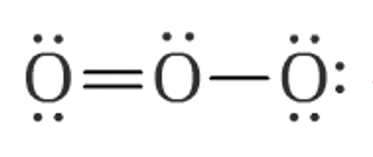
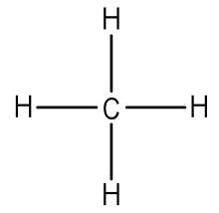
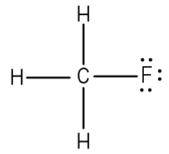
Which IMFs are present?
LD DD HB
LD
DD
--
LD
--
--
LD
DD
--

Slide 21
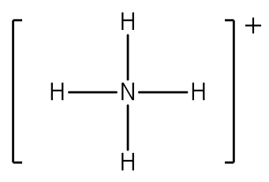
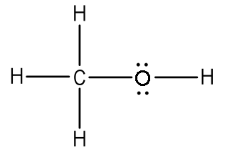
Which IMFs are present?
LD DD HB
LD
--
--
LD
--
HB
LD
DD
HB

Slide 22
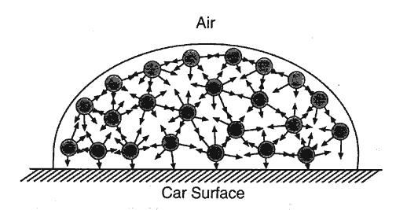
Why are IMFs important?
More IMFs make a substance “stick together” more. This increases:
Melting & Boiling points
Cohesion
Surface Tension: the attractive force between particles in a liquid that minimizes surface area.

Slide 23
Why are IMFs important?
Polar substances also stick to other polar substances, leading to:
Capillary action: attractive force between the surface of a liquid and the surface of a solid
Mutual Solubility & Miscibility (dissolving & mixing together)

Slide 24
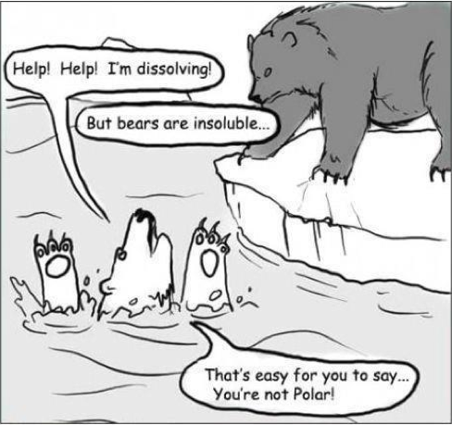
Why are IMFs important?
Dissolving & mixing:
Polar molecules (like water) are attracted to other polar molecules. They dissolve/mix together easily.
Nonpolar molecules (like oil) do not dissolve/mix with polar substances.

